Slide 1
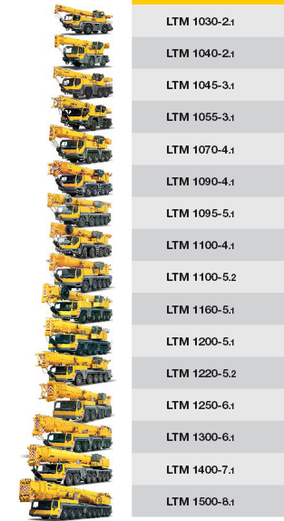
Unterwagen
Mercedes-Benz OM 906 LA; 205 kW; PLD; R6
Mercedes-Benz OM 906 LA; 205 kW; PLD; R6
LIEBHERR D936L – A6; 270 kW; PLD; R6
LIEBHERR D936L – A6; 270 kW; PLD; R6
LIEBHERR D936L – A6; 270 kW; PLD; R6
LIEBHERR D846 – A7; 350 kW; CR; R6
LIEBHERR D846 – A7; 370 kW; CR; R6
LIEBHERR D846 – A7; 350 kW; CR; R6
LIEBHERR D846 – A7; 370 kW; CR; R6
LIEBHERR D846 – A7; 370 kW; CR; R6
LIEBHERR D846 – A7; 370 kW; CR; R6
LIEBHERR D846 – A7; 370 kW; CR; R6
LIEBHERR D9508 – A7; 450 kW; CR; V8
LIEBHERR D9508 – A7; 450 kW; CR; V8
LIEBHERR D9508 – A7; 450 kW; CR; V8
LIEBHERR D9508 – A7; 500 kW; CR; V8

Slide 2
Oberwagen / Drehbühne
LIEBHERR D934S – A6; 145 kW; PLD; R4
LIEBHERR D934S – A6; 145 kW; PLD; R4
LIEBHERR D934S – A6; 145 kW; PLD; R4
LIEBHERR D934S – A6; 145 kW; PLD; R4
LIEBHERR D934S – A6; 145 kW; PLD; R4
LIEBHERR D934S – A6; 145 kW; PLD; R4
LIEBHERR D934L – A6; 180 kW; PLD; R4
LIEBHERR D934L – A6; 180 kW; PLD; R4
LIEBHERR D924 – A4; 180 kW; R4
LIEBHERR D936L – A6; 240 kW; PLD; R6
LIEBHERR D936L – A6; 240 kW; PLD; R6

